Slide 1

Chapter 2
Research Ethics

Slide 2
Research Ethics
ETHICS
Some questions cannot be answered using an experimental design because they would be unethical.
Example: The effect of experiencing abuse as a child on levels of self-esteem.
You cannot randomly assign participants to receive abuse.
This would need to be studied using other approaches such as case studies or surveys.

Slide 3
ETHICS:
RESEARCH INVOLVING HUMAN PARTICIPANTS
Research involving human participants must adhere to strict guidelines.
Institutional Review Board (IRB) – Committee of administrators, scientists, and community members that reviews proposals for research involving human participants.
Exist at any research institution that receives federal support for research involving human participants.
Generally, IRB must approve research proposal before it can proceed.
Informed consent - process of informing a research participant about what to expect during an experiment and then obtaining the person’s consent to participate. Includes:

Slide 4
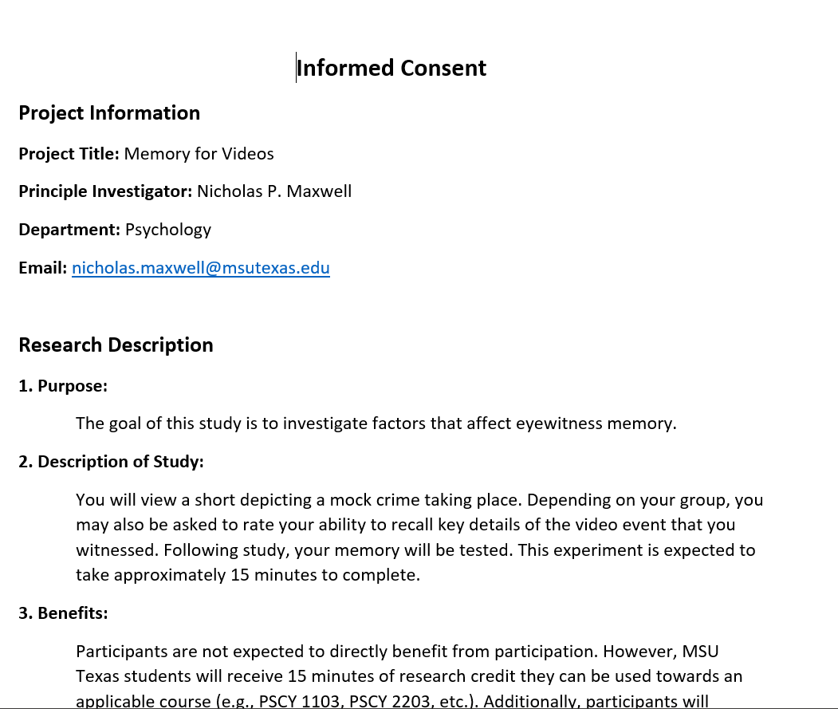
Informed Consent Example

Slide 5
Ethical Issues in Social Research
Anonymity and Confidentiality
  Not the same thing!
Anonymity – Neither the researchers nor the readers of the findings can identify a given response with a given respondent.
Confidentiality – Researcher can identify a given person’s responses but promises not to do so publicly.

Slide 6

Watson and “Little Albert”

Slide 7
Landis (1924)
Goal: Match human facial expressions to specific emotions
Had participants engage in a variety of tasks designed to elicit specific emotions
    Listening to Jazz
    Reading scripture
    Smelling ammonia
    Sticking their hands in a bucket of live frogs (unaware of frogs)
    Fired a gun in close proximity to the subjects
    Exposed them to pornography
    Handed them a live rat, a knife, and asked subject to decapitate the rate
Notes:
Sometimes the frog bucket had a live electrical wire at the bottom
Confronted with this high-stress situation, some persons started crying, others hysterically laughed; some completely froze, others burst out into swearing.

Slide 8


Slide 9


Slide 10

The Stanford Prison Experiment (1971)
Simulated a prison environment
  Individuals randomly selected to be “guards” or “prisoners”
  Given uniforms, fully thrown into roles
  “Guards” engaged in all sorts of psychological abuse towards “prisoners”

Slide 11
The Stanford Prison Experiment (1971)
Considered one of the most unethical psych experiments ever conducted
Experiment only lasted 6 days (planned to last two weeks)

Slide 12
National Research Act (1974)
Established regulations designed to protect human participants in research.
Created institutional review boards (IRBs) to ensure that the welfare of participants is adequately protected

Slide 13
Some Questions on Ethics
Does being a participant in a scientific study distort real-life behavior? Do you think people behave differently in an experimental setting vs. everyday life?
What if the only way to collect valid information requires putting participants at risk?

Slide 14
DECEPTION (1)
Deception – Purposely misleading experiment participants in order to maintain the integrity of the experiment.
Is it ethical to deceive participants?
Debriefing - when an experiment involved deception, participants are told complete and truthful information about the experiment at its conclusion.

Slide 15
DECEPTION (2)
The Tuskegee Syphilis study
Ethical guidelines have not always existed.
In 1932, participants were recruited in an experiment studying syphilis in black men.
Participants that tested positive were not informed that they had the disease.
Although no cure existed at the beginning of the study, a cure was found in 1947 (penicillin), but it was not administered to participants.
Many participants unknowingly spread the disease and many died.
https://www.cdc.gov/tuskegee/timeline.htm

Slide 16
BAD SCIENCE & RETRACTION: THE VACCINE-AUTISM MYTH
Many peer-reviewed publications published research making claims that routine childhood vaccines cause some children to develop autism.
Since these reports, large-scale research was carried out suggesting that vaccinations are not responsible for causing autism.
Many of the original studies have since been retracted.
It was found that the leading research in the original study had a financial interest in establishing a link between childhood vaccines and autism.
Unfortunately the initial claims were publicized and many people still think vaccinations cause autism.

Slide 17
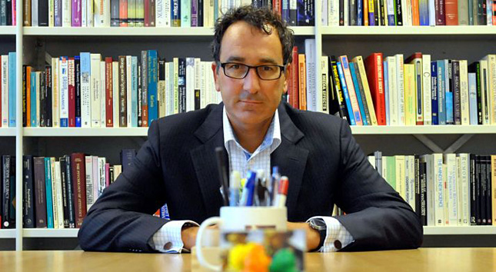
The other side of Research Ethics: Research Fraud
Notes:
Dutch Social Psychologist
Very successful, highly publicized work:
Much of his work was based on fake data…
Active from 1997 – 2011
At least 30 papers were retracted!
Eventually got caught after other researchers started questioning how he always got perfect results…
Trash-filled environments bring out racist tendencies in individuals
Individuals who eat meat tend to be less social and more selfish

Slide 18
Combatting Research Fraud
Preregistration
  The practice of researchers reporting their research design, predictions, and plans for data analyses before conducting their study.
  Stick to the plan, regardless of what happens!
Open Science Practices
  Data is freely shareable with other researchers
  Idea is that any one can inspect your data, materials, etc.
  Transparency should cut down on fraud

